Slide 1
Political science introduction lecture 2
Marem Buzurtanova
Al-Farbi KazNU
Department of Political Science and Political Technologies

Slide 2
Political science introduction lecture 2
MODULE 1 POLITICAL THOUGHT THROUGHOUT THE HISTORY
(weeks one-five)
Lecture 2: Antiquity and Classics; Middle Ages
Lecture 3: Renaissance and Enlightenment
Lecture 4: 19th Century
Lecture 5: 20th and 21st Centuries

Slide 3
Political science introduction lecture 2
Lecture outline
What is renaissance;
What is enlightenment;
What is modernity;
Machiavelli (1469 – 1527);
Hobbes (1588 - 1679);
John Locke (1632 –1704);
Jean-Jacques Rousseau (1712 –1778)

Slide 4
Political science introduction lecture 2
Renaissance
Renaissance replaced the Middle Ages and transformed the life in Europe to prepare it for the Enlightenment and Modernity.
started in Italy at the beginning of the 14th century –
lasted until the end of the 16th century
revival of secularism, humanism and anthropocentrism
revived interest in classical culture
Nikolai Copernicus, Giordano Bruno, Michel Montaigne, Thomas More, Erasmus of Rotterdam, Martin Luther, Tommaso Campanella, and Niccolo Machiavelli

Slide 5
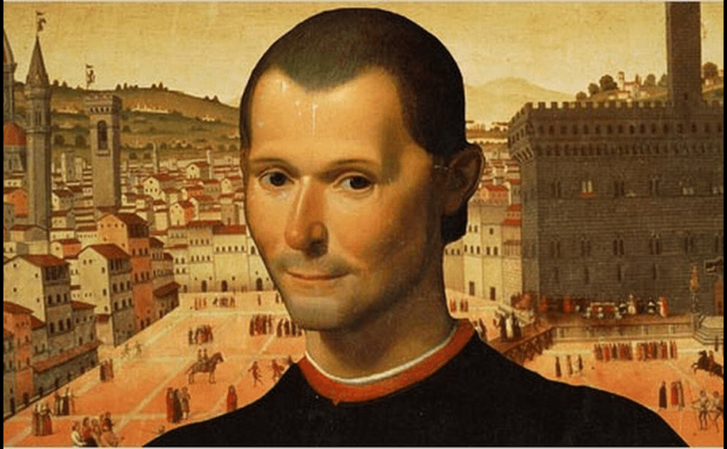
Political science introduction lecture 2
Machiavelli (1469 – 1527)

Slide 6
Political science introduction lecture 2
Machiavelli (1469 – 1527)
born in Florence into an aristocratic family;
after restoration of the republic in Florence, was a government official; a diplomat, a chief of militia;
after the fall of the republic, was banished from the city, later imprisoned and tortured, then released;
a founder of the “Realist” school of International Relations.

Slide 7
Political science introduction lecture 2
The Machiavelli’s Prince (1513) describes the methods of seizing and maintaining power, ruling and successful warfare.
forms of government: republics and monarchy.
ways of coming into power: 1) by weapons, strength or violence, 2) by luck; 3) or by virtue.
non-coercive instruments of power as well, namely language, mores and customs.
wise ruler knows how to deal with both people and the elite.
wise ruler knows how to use violence.
importance of appearances, PR.

Slide 8
Political science introduction lecture 2
The Discourses on Livy (1517) discusses historical events, Roman Republic in particular.
more universal claims on the nature of political power and institutions that reflect his philosophy of republicanism.
Good government: strong institutions, balances of interests, while ensuring the rule and prosperity of the elite are the necessary for prosperous and secure state, where the rule of law guaranties liberty for all.
Security (specifically internal) is linked to liberty and helps avoid revolts and riots that could weaken and undermine the state leading to its degradation, disintegration, or conquest.
discusses how to win the people of a conquered nation assimilating them into the republic.

Slide 9
Political science introduction lecture 2
Enlightenment
The Age of Enlightenment (the Age of Reason) – the period between the two revolutions: the “Glorious Revolution” in England (1688) and the French Revolution (1789).
rationalism and free-thinking;
limitation of the powers of aristocracy and the influence of the church;
scientific revolution.
Hobbes, Locke, D.Hume, A.Smith, Voltaire, Roussau, Montesquieu, E.Kant, A.Tocqueville.

Slide 10
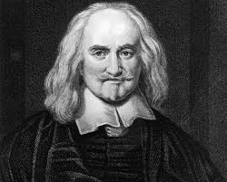
Political science introduction lecture 2
Hobbes (1588 - 1679)

Slide 11
Political science introduction lecture 2
Hobbes (1588 - 1679)
• one of the founders of modern political philosophy;
• one of social contract theorists;
• contributed to other fields, i.e. history, law, theology, moral philosophy;
• wrote also on geometry, physics of gases;
• born in a middle class family of clergyman;
• went to Oxford and left it for Cambridge;
• lived under the patronage of the Earl of Devonshire;
• lived through the “Glorious Revolution” and civil war in England.

Slide 12
Political science introduction lecture 2
Hobbes’ three forms of political constitution:
democracy,
aristocracy,
monarchy.
Hobbes was skeptical about democracy because “greater wisdom is inaccessible to the mob rule” and “partisan politics that emerge under democracy may lead to a civil war”.
For Hobbes, aristocracy is better, but monarchy is the best of them all. The more absolute and undivided is the power of the monarch, the better.

Slide 13
Political science introduction lecture 2
Hobbes’ state:
“state of nature”; no law and everyone is free do to what one pleases; the strong always wins, the weak always suffer, life is “solitary, poor, nasty, brutish, and short”;
primordial equality of people, the same, unlimited “rights to everything” and the free will;
state is a coercive power;
a contract between people and the powerful when the former devote their freedom in exchange of security.

Slide 14
Political science introduction lecture 2
Hobbes’ legal positivism
opposed to natural law doctrine;
existence and content of law depends on social facts and reflects its power structures.

Slide 15
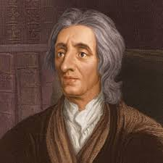
Political science introduction lecture 2
John Locke (1632 –1704)

Slide 16
Political science introduction lecture 2
John Locke (1632 –1704)
• English philosopher and physician, follower of the British empiricists school;
• "Father of Liberalism";
• Locke's father supported the Parliamentarian forces during the English Civil War;
• went to Westminster School and Oxford;
• enjoyed patronage of Ashley Lord Chancellor (1st Earl of Shaftesbury);
• served as Secretary of the Board of Trade and Plantations and Secretary to the Lords Proprietors of Carolina, was involved in the matters of international trade and economics;
• influenced the newly established Whig movement (the major Liberal opposition of the Conservatives);
• argued against absolute monarchy and proposed the idea of political legitimacy bases on individual consent.

Slide 17
Political science introduction lecture 2
Locke’s political opinions:
natural law doctrine; natural law (life, freedom, property) and positive laws (peace and security);
people are naturally predisposed for building societies that would maintain law and security;
right to property to be a natural right;
property included life, liberty and property (including intellectual property);
Liberty is a person’s freedom to dispose of his personality, actions, entire property as well as freedom of movement, the right to free labour and to its results.

Slide 18
Political science introduction lecture 2
Locke’s doctrine of freedom:
rejects personal dependence (slave and slave owner, serf and landowner, servant and master, patron and client);
should be based on law and justice;
constitutional monarchy;
separation of powers: legislative, executive and federal.

Slide 19
Political science introduction lecture 2
Locke’s theory of social contract:
State guarantees the flourishment of natural law and positive laws hence;
civil society;
rule of law;
right of the people to dispose a tyrannical government.

Slide 20
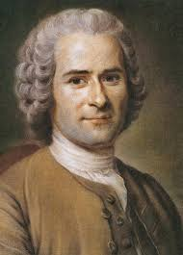
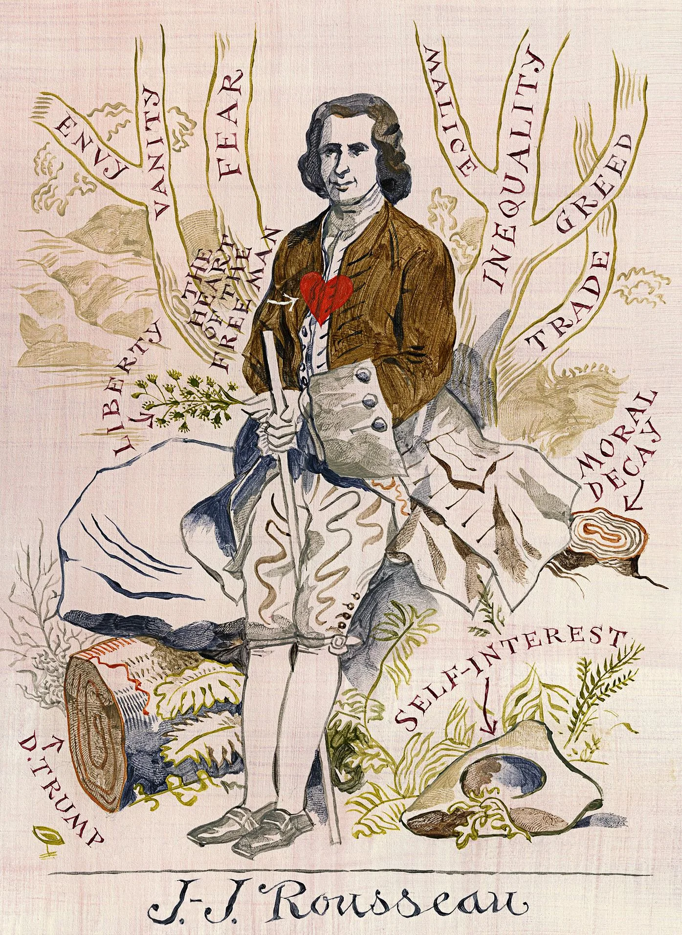
Political science introduction lecture 2
Jean-Jacques Rousseau (1712 –1778)

Slide 21
Political science introduction lecture 2
Jean-Jacques Rousseau (1712 –1778)
• writer, composer, philosopher – one of the three great social contract theorists;
• influenced the French Revolution and modern political, economic and educational thought;
• born in Geneva in a middle class Protestant family, later converted to Catholicism and reconverted to Calvinism;
• collaborated and fell out with l’ Académie des Sciences;
• had rather turbulent life;
• published a novel that caused the arrest warrant by the French parliament;
• buried in the Pantheon in Paris.

Slide 22
Political science introduction lecture 2
Rousseau’s social contract:
Equality not liberty - major concern was;
critical of private property; principle of reciprocity;
republican constitution;
people are the sole source of the state power.

Slide 23
Political science introduction lecture 2
Rousseau’s doctrine of people’s sovereignty indispensable for the French Revolution, successive constitutions of the French republics and many other republics, constitutional law, raise of nation-states in Europe and elsewhere.
The will of the people is inalienable and indivisible, infallible and absolute and finds its expression in the law that guarantee proper equality.

Slide 24
Political science introduction lecture 2
Rousseau was in favour of various practises of direct and representative democracy such as elections, referenda, sand elf-government.
Rousseau believed that accountability is crucial for proper realization of the will of the people and argues that the right to recall a representative should be granted to the votes at all levels.

Slide 25
Political science introduction lecture 2
Modernity (modern way of life, of thinking, of being) is a more complex and broad concept that Renaissance or Enlightenment describing a society formed by capitalism, industrialization, urbanization, secularization, institutions and civil society:
people are independent rational actors, while in a traditional society, people follow the ways of their fathers and grandfathers;
physical (geographical) and social mobility increases considerably and leads to the changes of unprecedented scope in all aspects of life;
constant and rapid economic growth, technical development, and progress.

